Slide 1
BUS Booking System Presented by Team-4 Pratyush Srivastava Praveen Parihar Priyanka thorat Neeraj Kumar Rakesh Ranjan

Slide 2
Technology used
MySQL Database
JSP
Database Layer(Connection , Sending & Receiving Of Data)
Server layer(Servlets)
HTML, CSS, JavaScript
AWS

Slide 3
A JSP page consists of HTML tags and JSP tags. The JSP pages are easier to maintain than Servlet because we can separate designing and development. It provides some additional features such as Expression Language, Custom Tags, etc
JAVA BEAN CLASSES
Java beans incorporate a set of objects into one accessible object that can be accessed easily from any application. This single accessible object is maintainable, customizable, and reusable.
JSP

Slide 4
DATABASE LAYER The Data Access Object is basically an object or an interface that provides access to database or any other persistence storage.
For example if we want to perform some operation for table “employee” present inside the database interface
EmployeeDAO { List<Employee> findById(); boolean insertEmployee(Employee employee); boolean updateEmployee(Employee employee); boolean deleteEmployee(Employee employee); }

Slide 5
Server Layer
Java Servlets are programs that run on a Web or Application server and act as a middle layer between a requests coming from a Web browser or other HTTP client and databases or applications on the HTTP server. Using Servlets, we can take input from user through web page, and we can present records from a database or another source, and create dynamic web pages .

Slide 6
HTML
HTML stands for Hyper Text Markup Language HTML is used for creating Web pages HTML describes the structure of a Web page HTML consists of a series of elements HTML elements that tell the browser how to display the content
CSS
CSS stands for Cascading Style Sheets CSS describes how HTML elements are to be displayed on screen, paper, or in other media CSS is the language we use to style an HTML document.

Slide 7
JAVA SCRIPT
JavaScript is a light-weight object-oriented programming language which is used by several websites for scripting the webpages. It is an interpreted programming language that enables dynamic interactivity on websites when applied to an HTML document.

Slide 8
AWS
The AWS service is provided by the Amazon that uses distributed IT infrastructure to provide different IT resources available on demand. It provides different services such as infrastructure as a service (IaaS), platform as a service (PaaS) and packaged software as a service (SaaS).

Slide 9
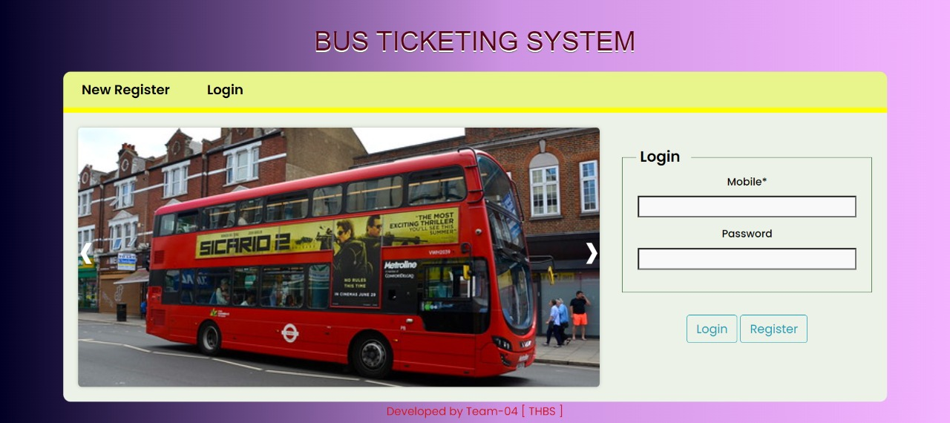

Slide 10
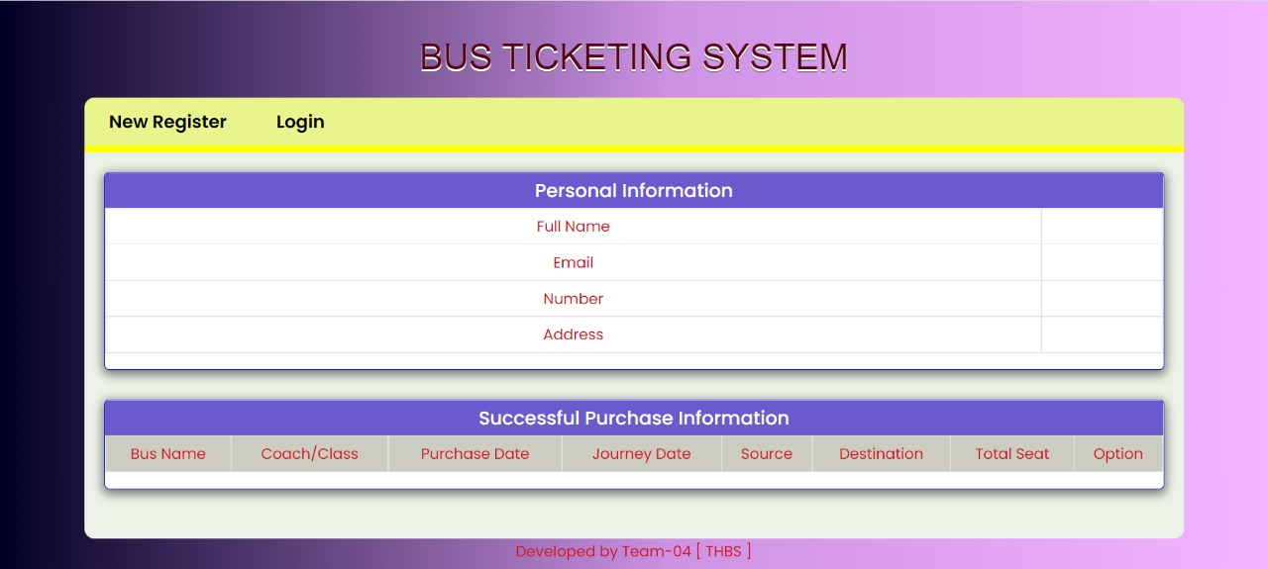

Slide 11
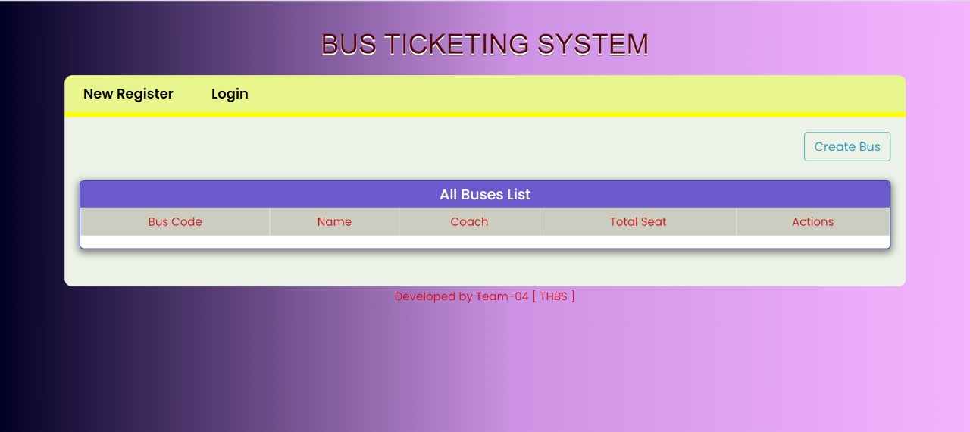

Slide 12
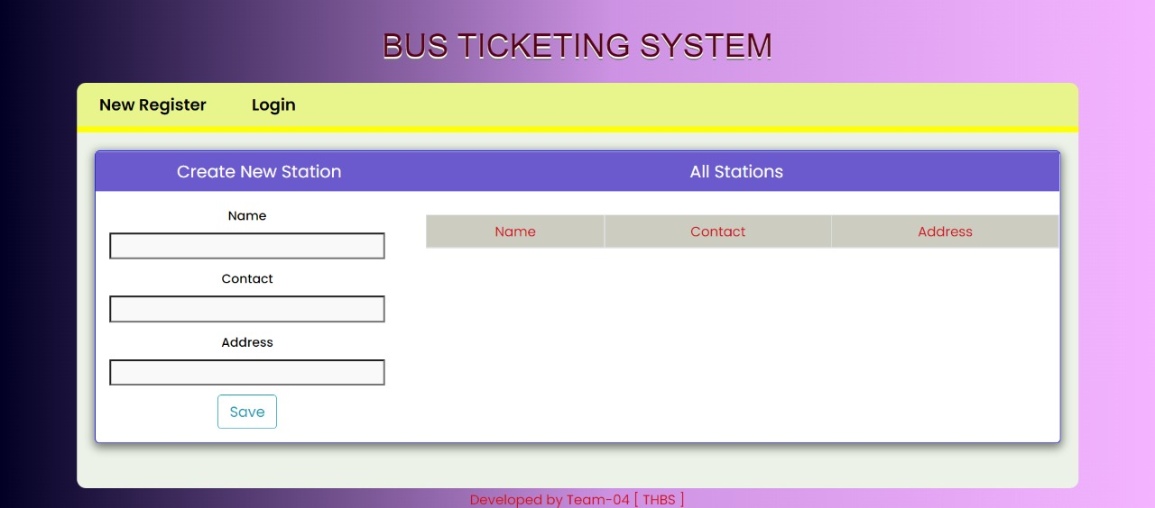

Slide 13
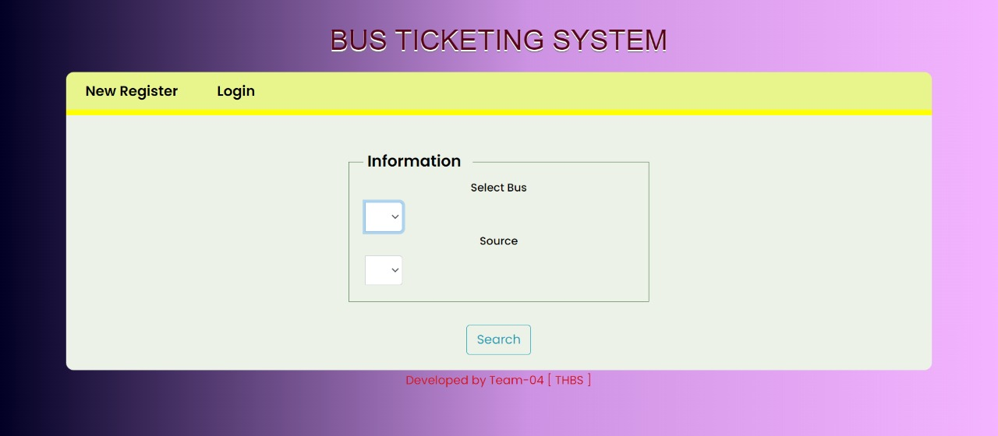

Slide 15
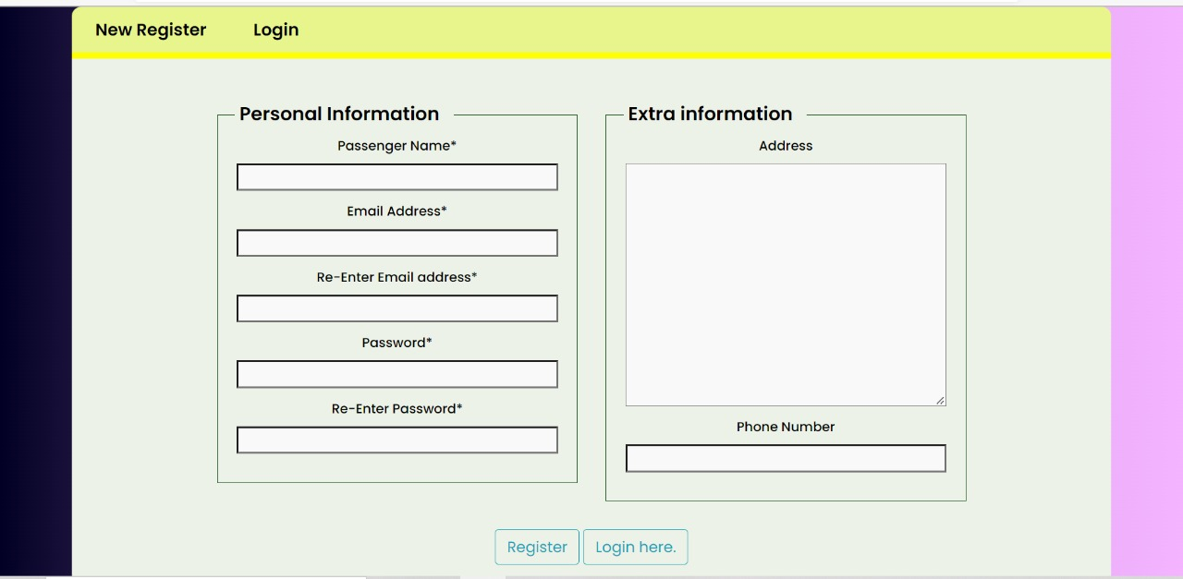

Slide 16
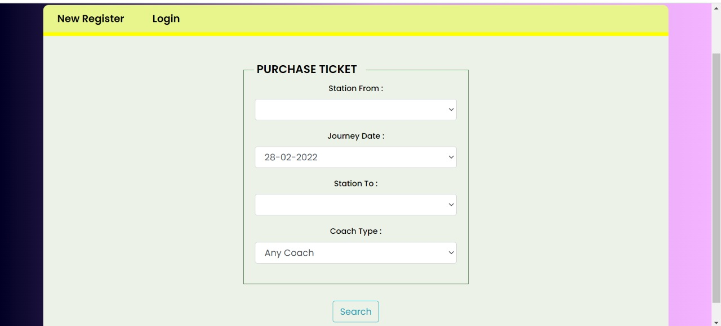

Slide 19


